Slide 1
Fake Troves: @HackingRedstone
2019-04-03
CS795/895
Puneeth Bikkasandra
Old Dominion University

Slide 2
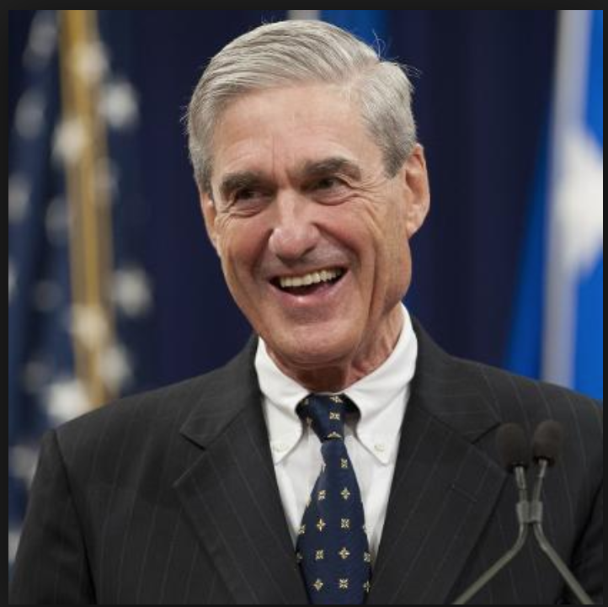
Robert Swan Mueller
American Lawyer
Former Marine
Former Director of FBI (2001 - 2013).
Special Counsel (DOJ) -
Russian Interference - 2016 United States Elections
(May, 2017 - Mar, 2019).
https://en.wikipedia.org/wiki/Robert_Mueller

Slide 3
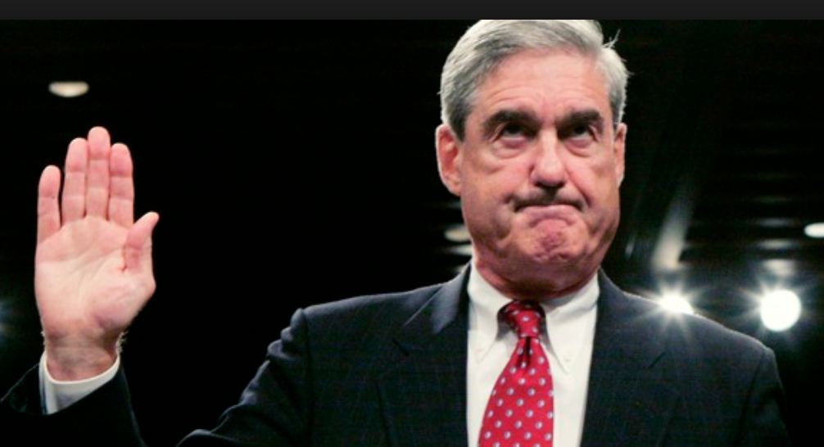
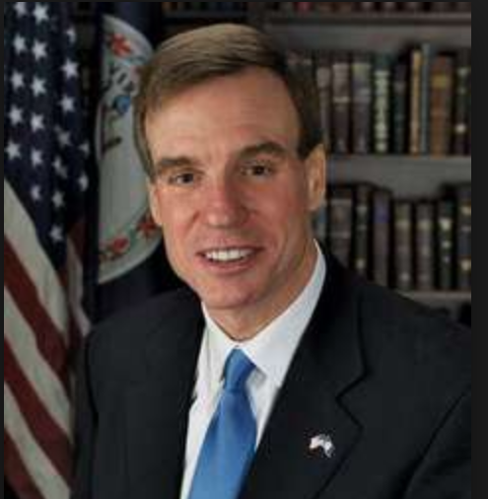
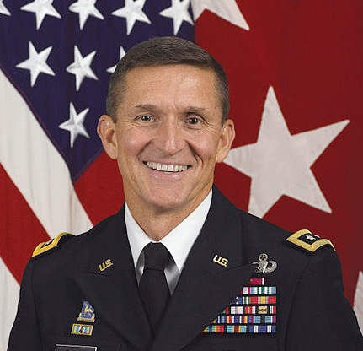
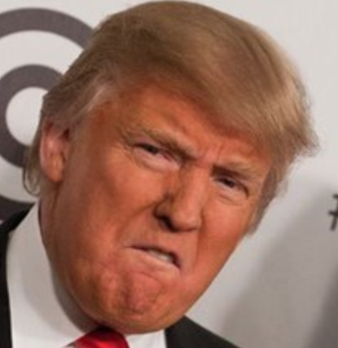
July, 2017:
Senator Mark Warner,
warns Constitutional Crisis, if fired!
December, 2017:
Michael.T.Flynn (NSA),
Testifies Trump teams direction to connect with Russians
May, 2017:
Appointed as Counsel of DOJ
February, 2018:
Mueller indicted 13 Russian individuals and 3 Russian companies for attempting to trick Americans in to consuming Russian propaganda
March, 2019:
Mueller concludes probe stating -
“The Special Counsel's investigation did not find that the Trump campaign or anyone associated with it conspired or coordinated with Russian in its efforts to influence the 2016 U.S. presidential election"
October, 2017:
Mueller, files charges against Trump campaign chairman for ‘Conspiracy against United States.’
May, 2018:
Trump tweets -
“The World's most expensive Witch Hunt has found nothing on Russia & me so now they are looking at the rest of the World!”
June, 2017:
Trump orders
to fire Mueller
https://en.wikipedia.org/wiki/Robert_Mueller

Slide 4
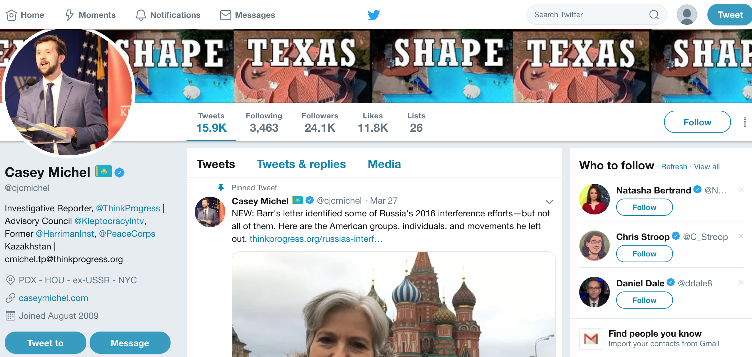
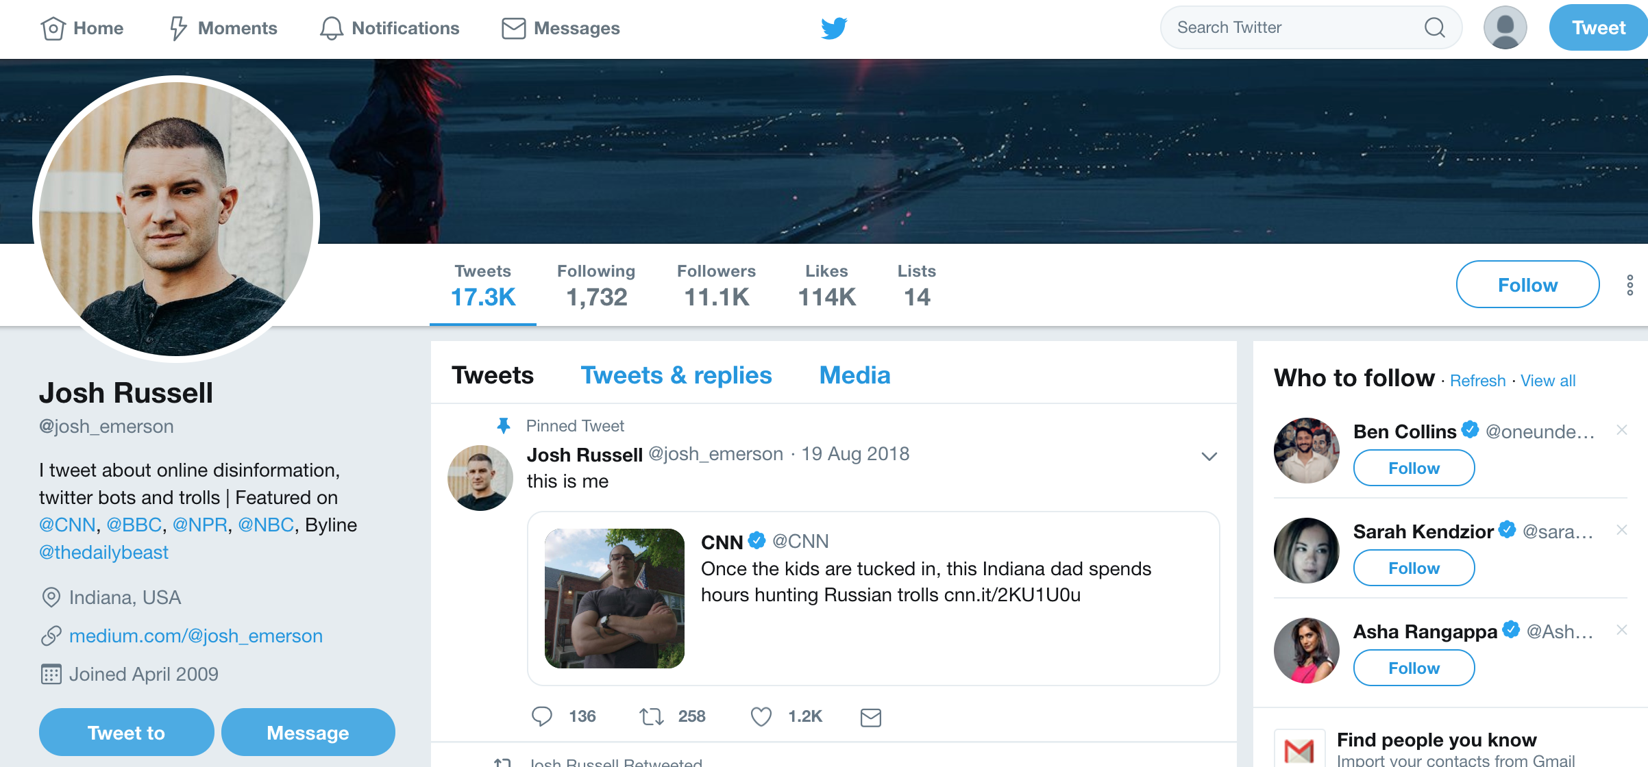
@josh_emerson and @cjcmichel: DM recipients @HackingRedStone
https://twitter.com/josh_emerson?lang=en
https://twitter.com/cjcmichel

Slide 5
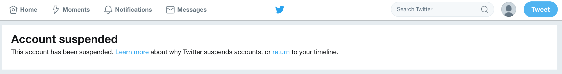
@HackingRedStone: Suspended!

Slide 6
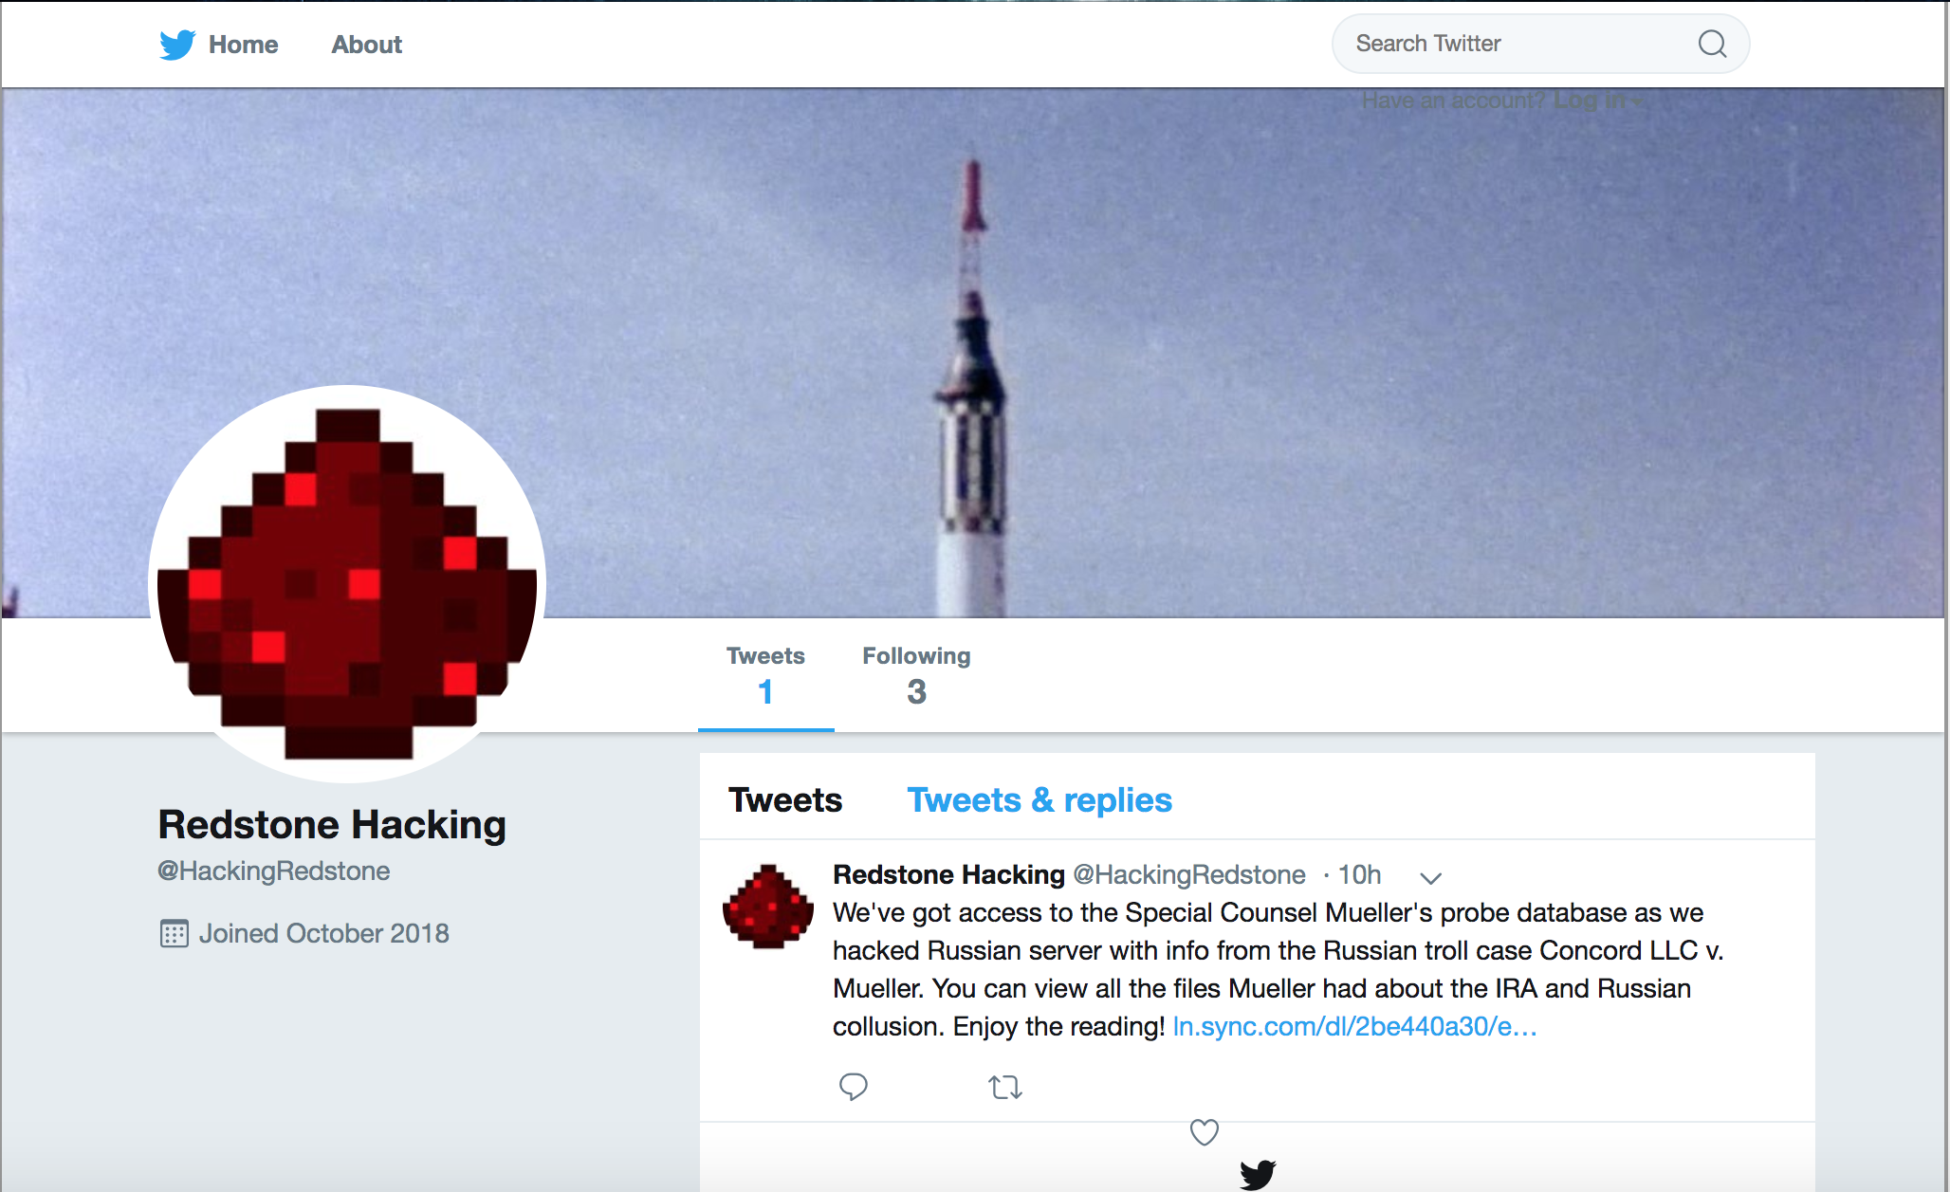
@HackingRedStone: November 2018
https://archive.is/3vOwn

Slide 7
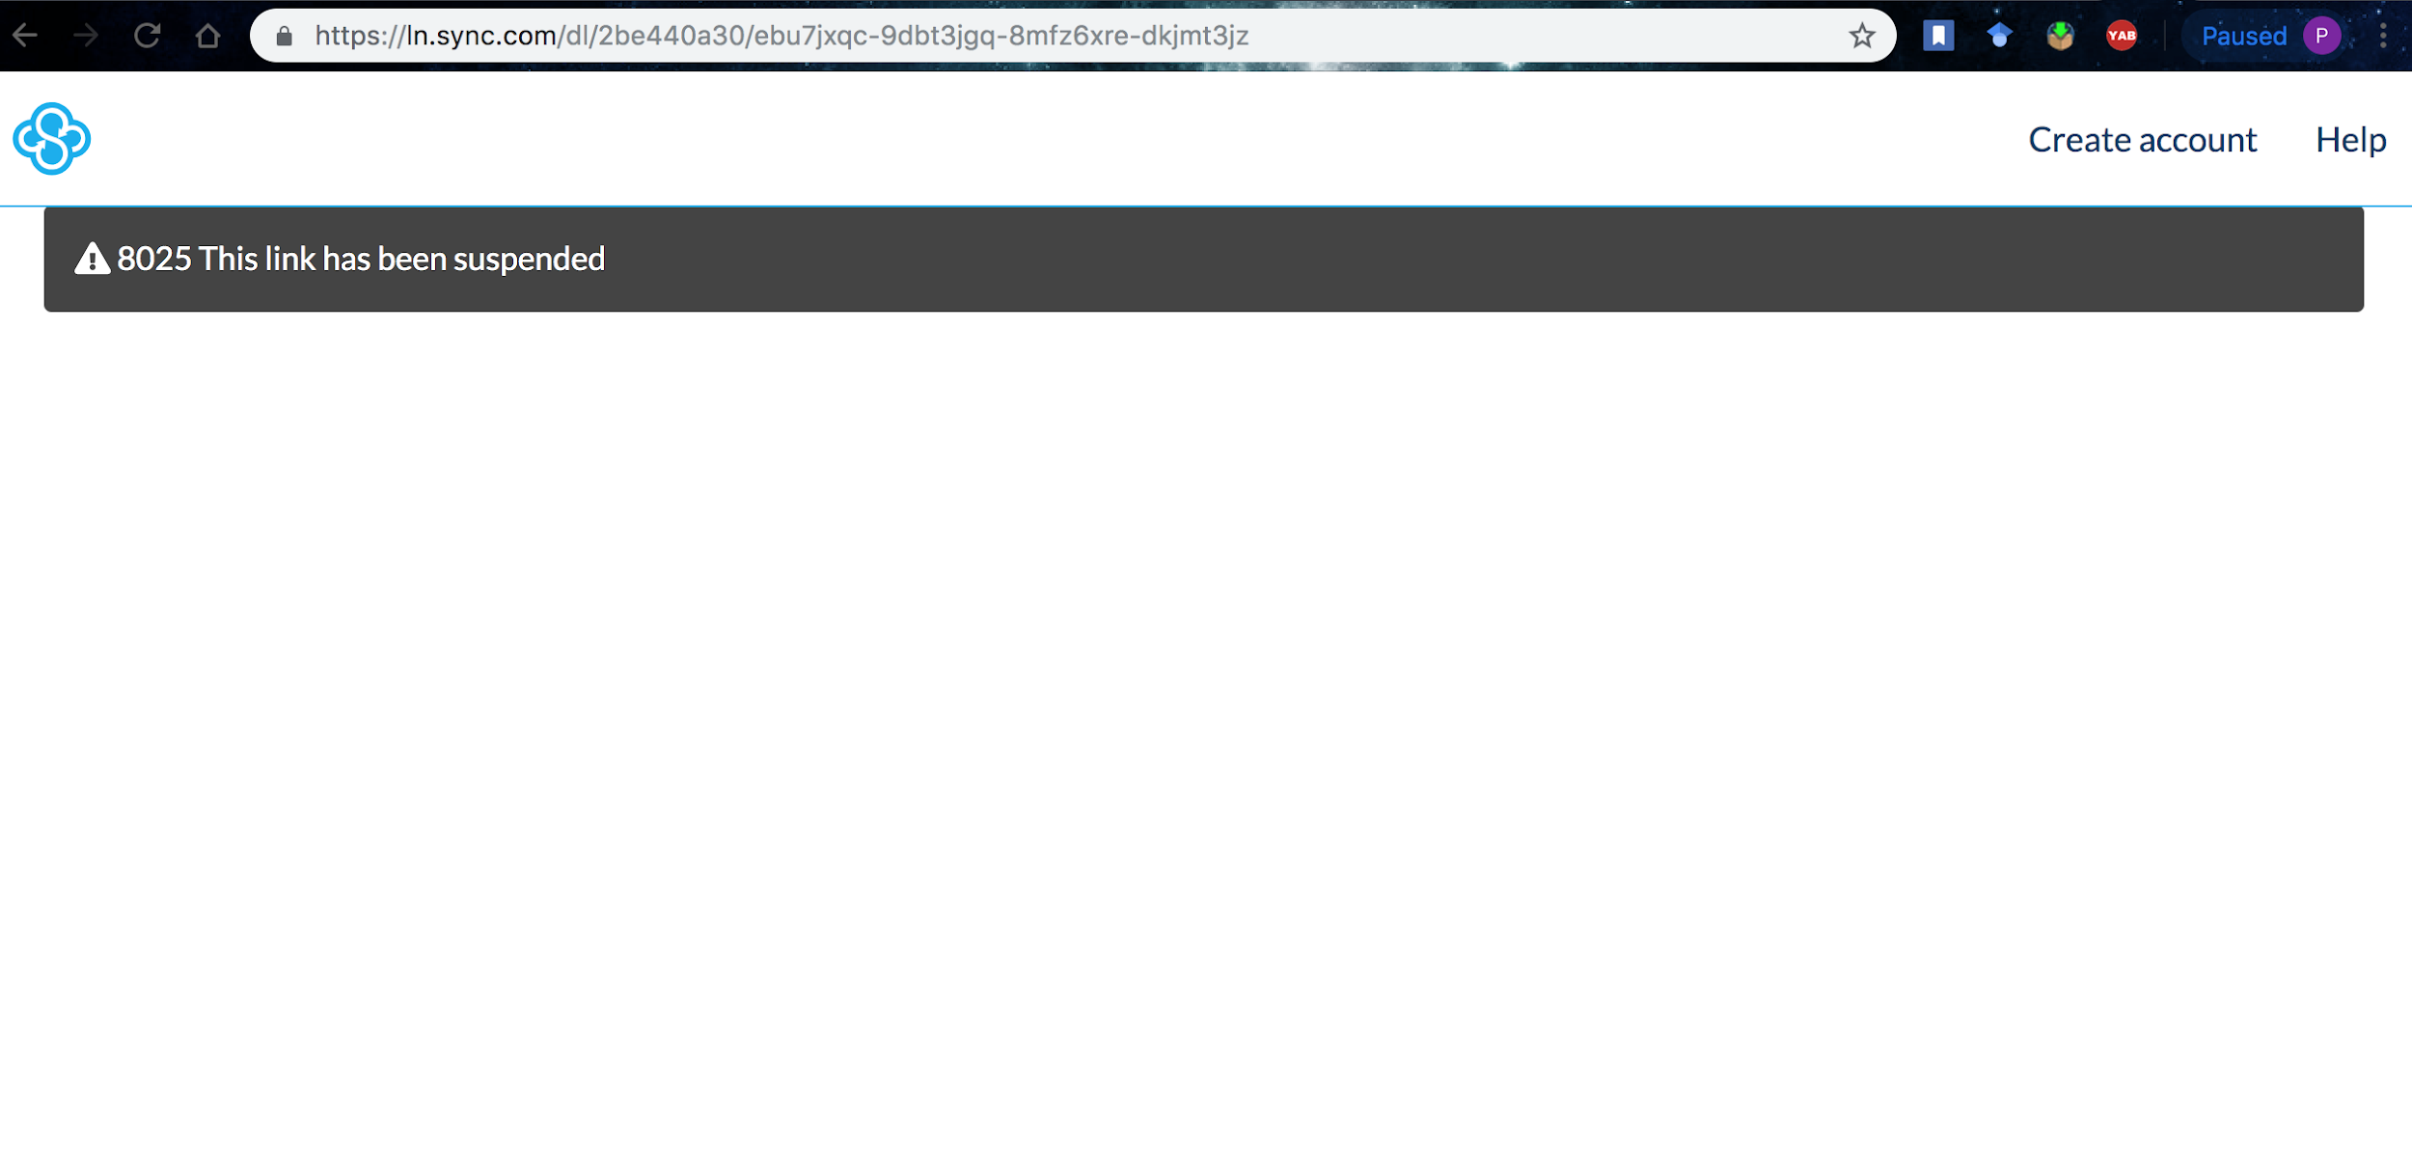
URL in the tweet does not have content!
https://ln.sync.com/dl/2be440a30/ebu7jxqc-9dbt3jgq-8mfz6xre-dkjmt3jz

Slide 8
Captured in archives?
curl --silent http://memgator.cs.odu.edu/timemap/link/https://ln.sync.com/dl/2be440a30/ebu7jxqc-9dbt3jgq-8mfz6xre-dkjmt3jz | grep datetime | awk '{print $1}'
<http://archive.md/20190130231855/https://ln.sync.com/dl/2be440a30/ebu7jxqc-9dbt3jgq-8mfz6xre-dkjmt3jz>;
<http://archive.md/20190202014634/https://ln.sync.com/dl/2be440a30/ebu7jxqc-9dbt3jgq-8mfz6xre-dkjmt3jz>;

Slide 9
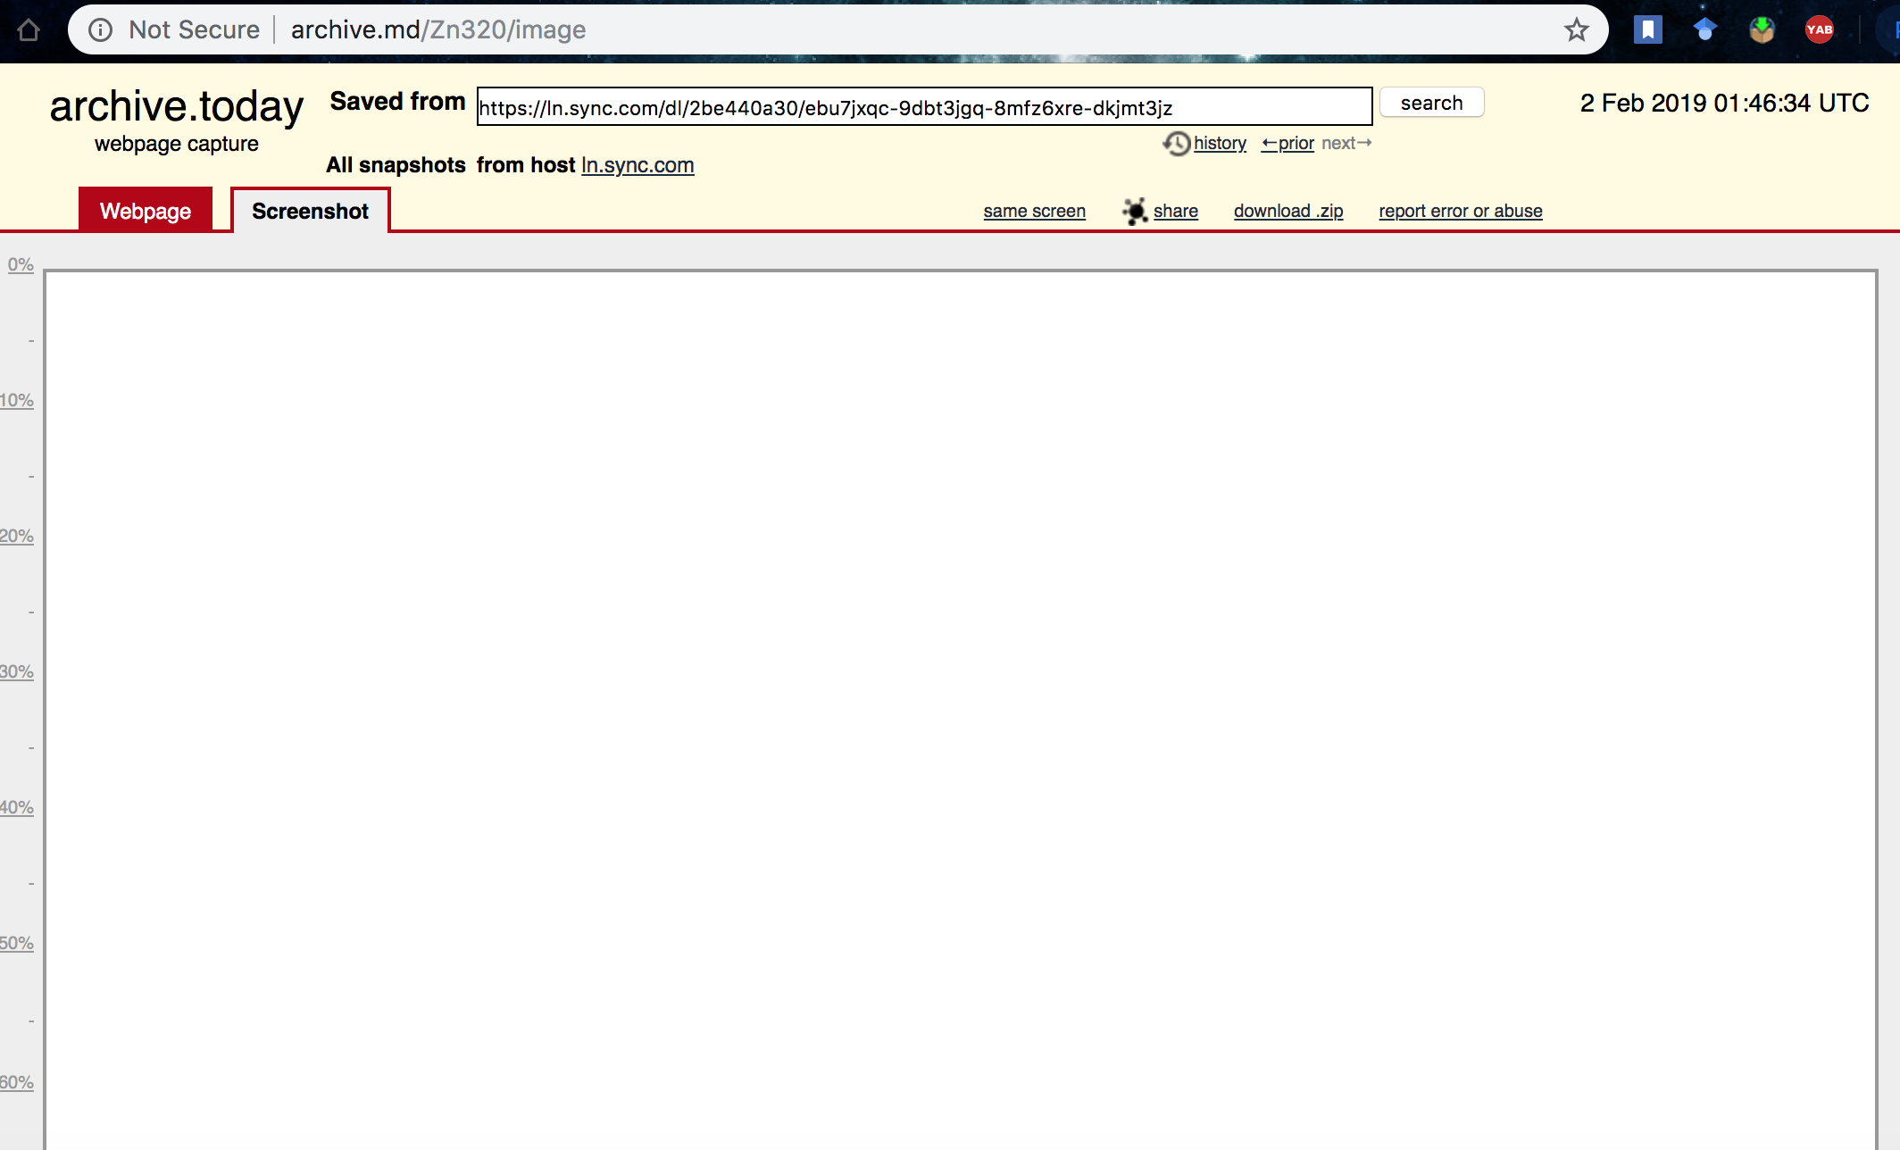
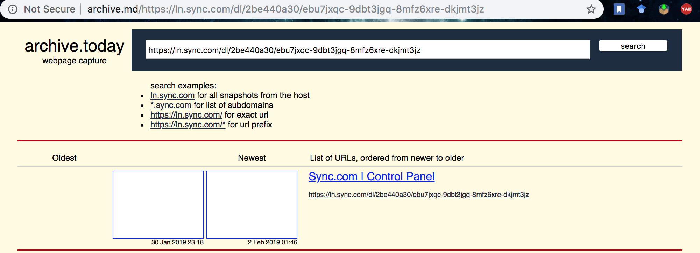
Archived pages do not render!
http://archive.md/https://ln.sync.com/dl/2be440a30/ebu7jxqc-9dbt3jgq-8mfz6xre-dkjmt3jz
http://archive.md/Zn320/image

Slide 10
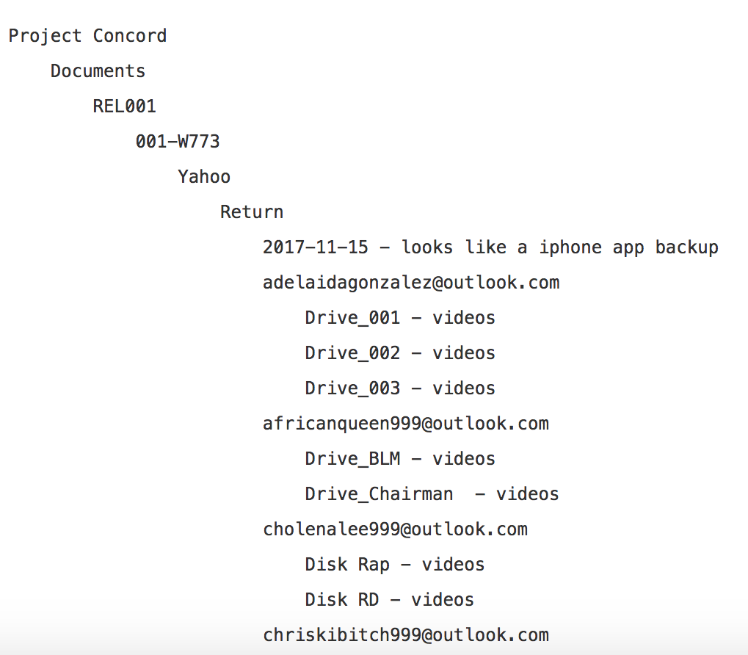
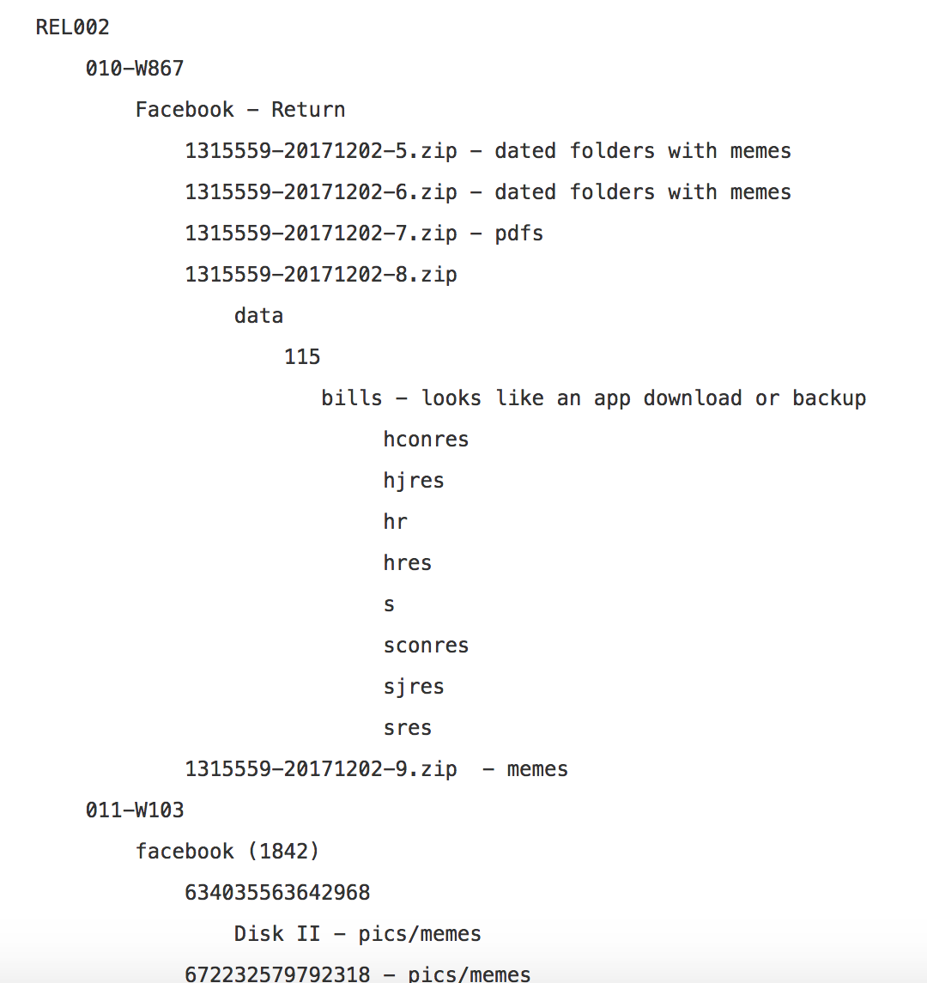
Fake Database Content: @HackingRedStone
https://pastebin.com/qaX4tyF8

Slide 11
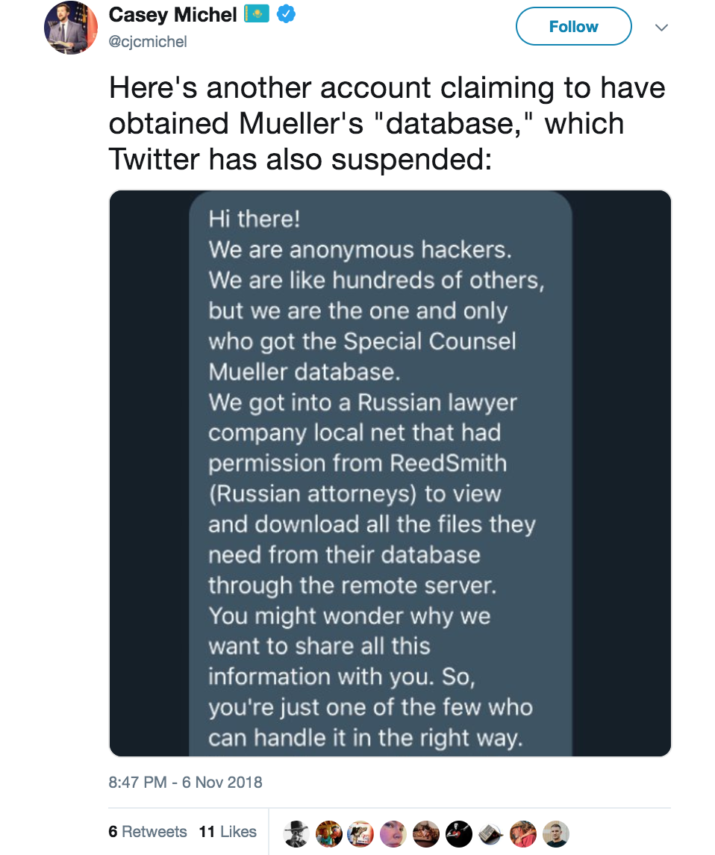
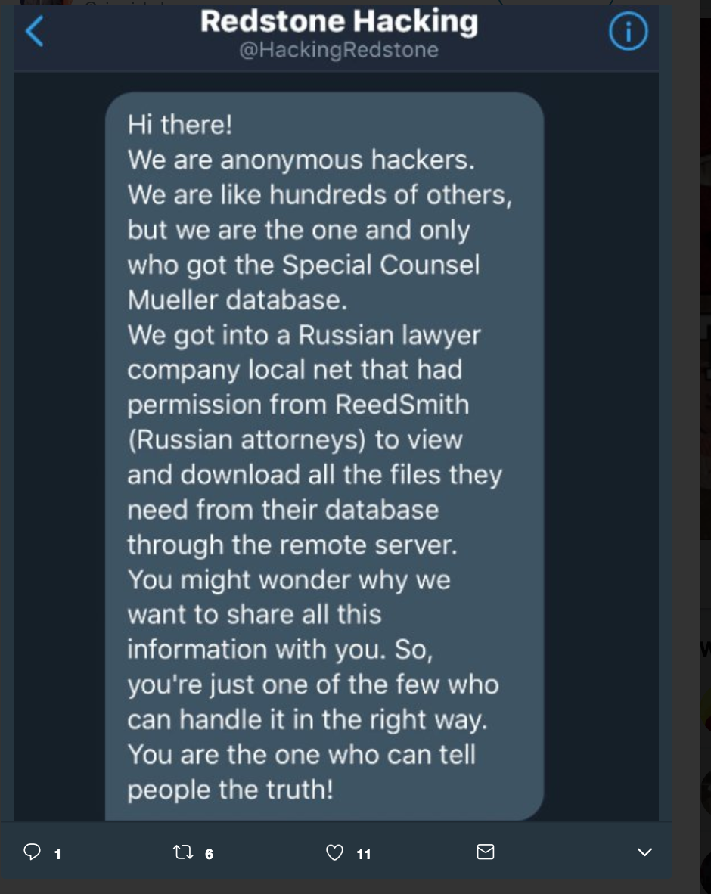
@HackingRedstone DM to @cjcmichel
https://twitter.com/cjcmichel/status/1059827233458741253

Slide 12
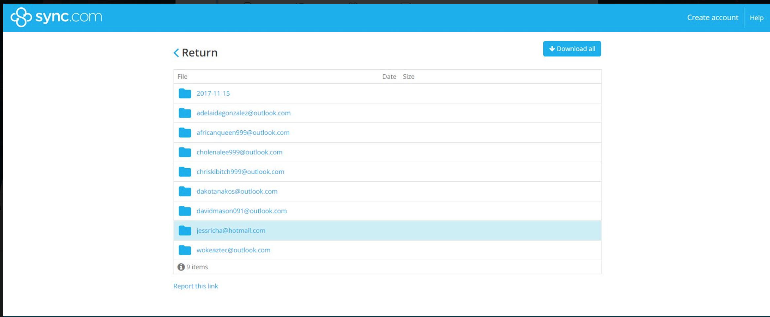
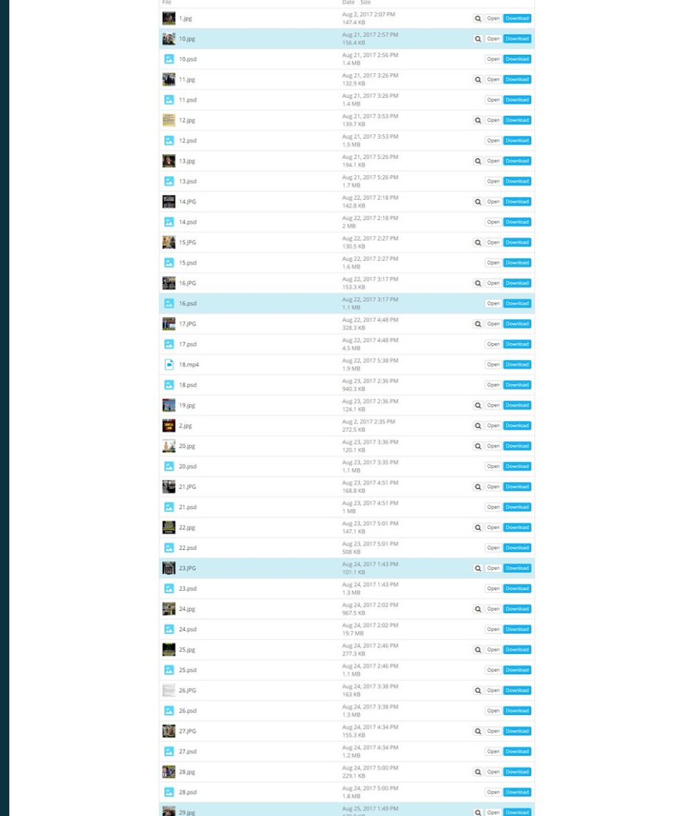
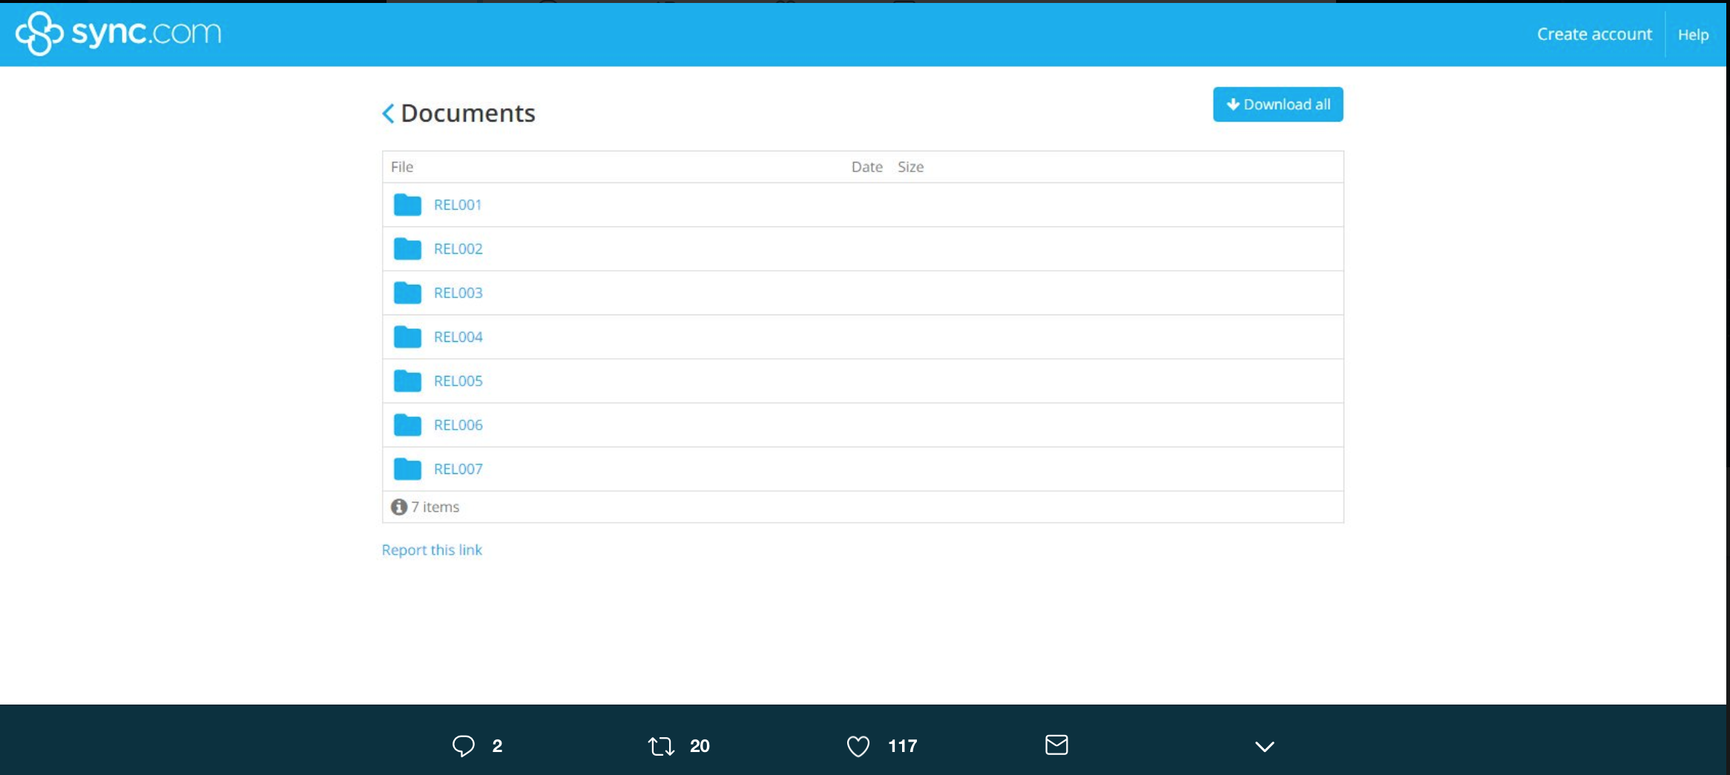
What did @HackingRedStone & @IRA_USA1 release?
https://twitter.com/josh_emerson/status/1060160355022921728

Slide 13
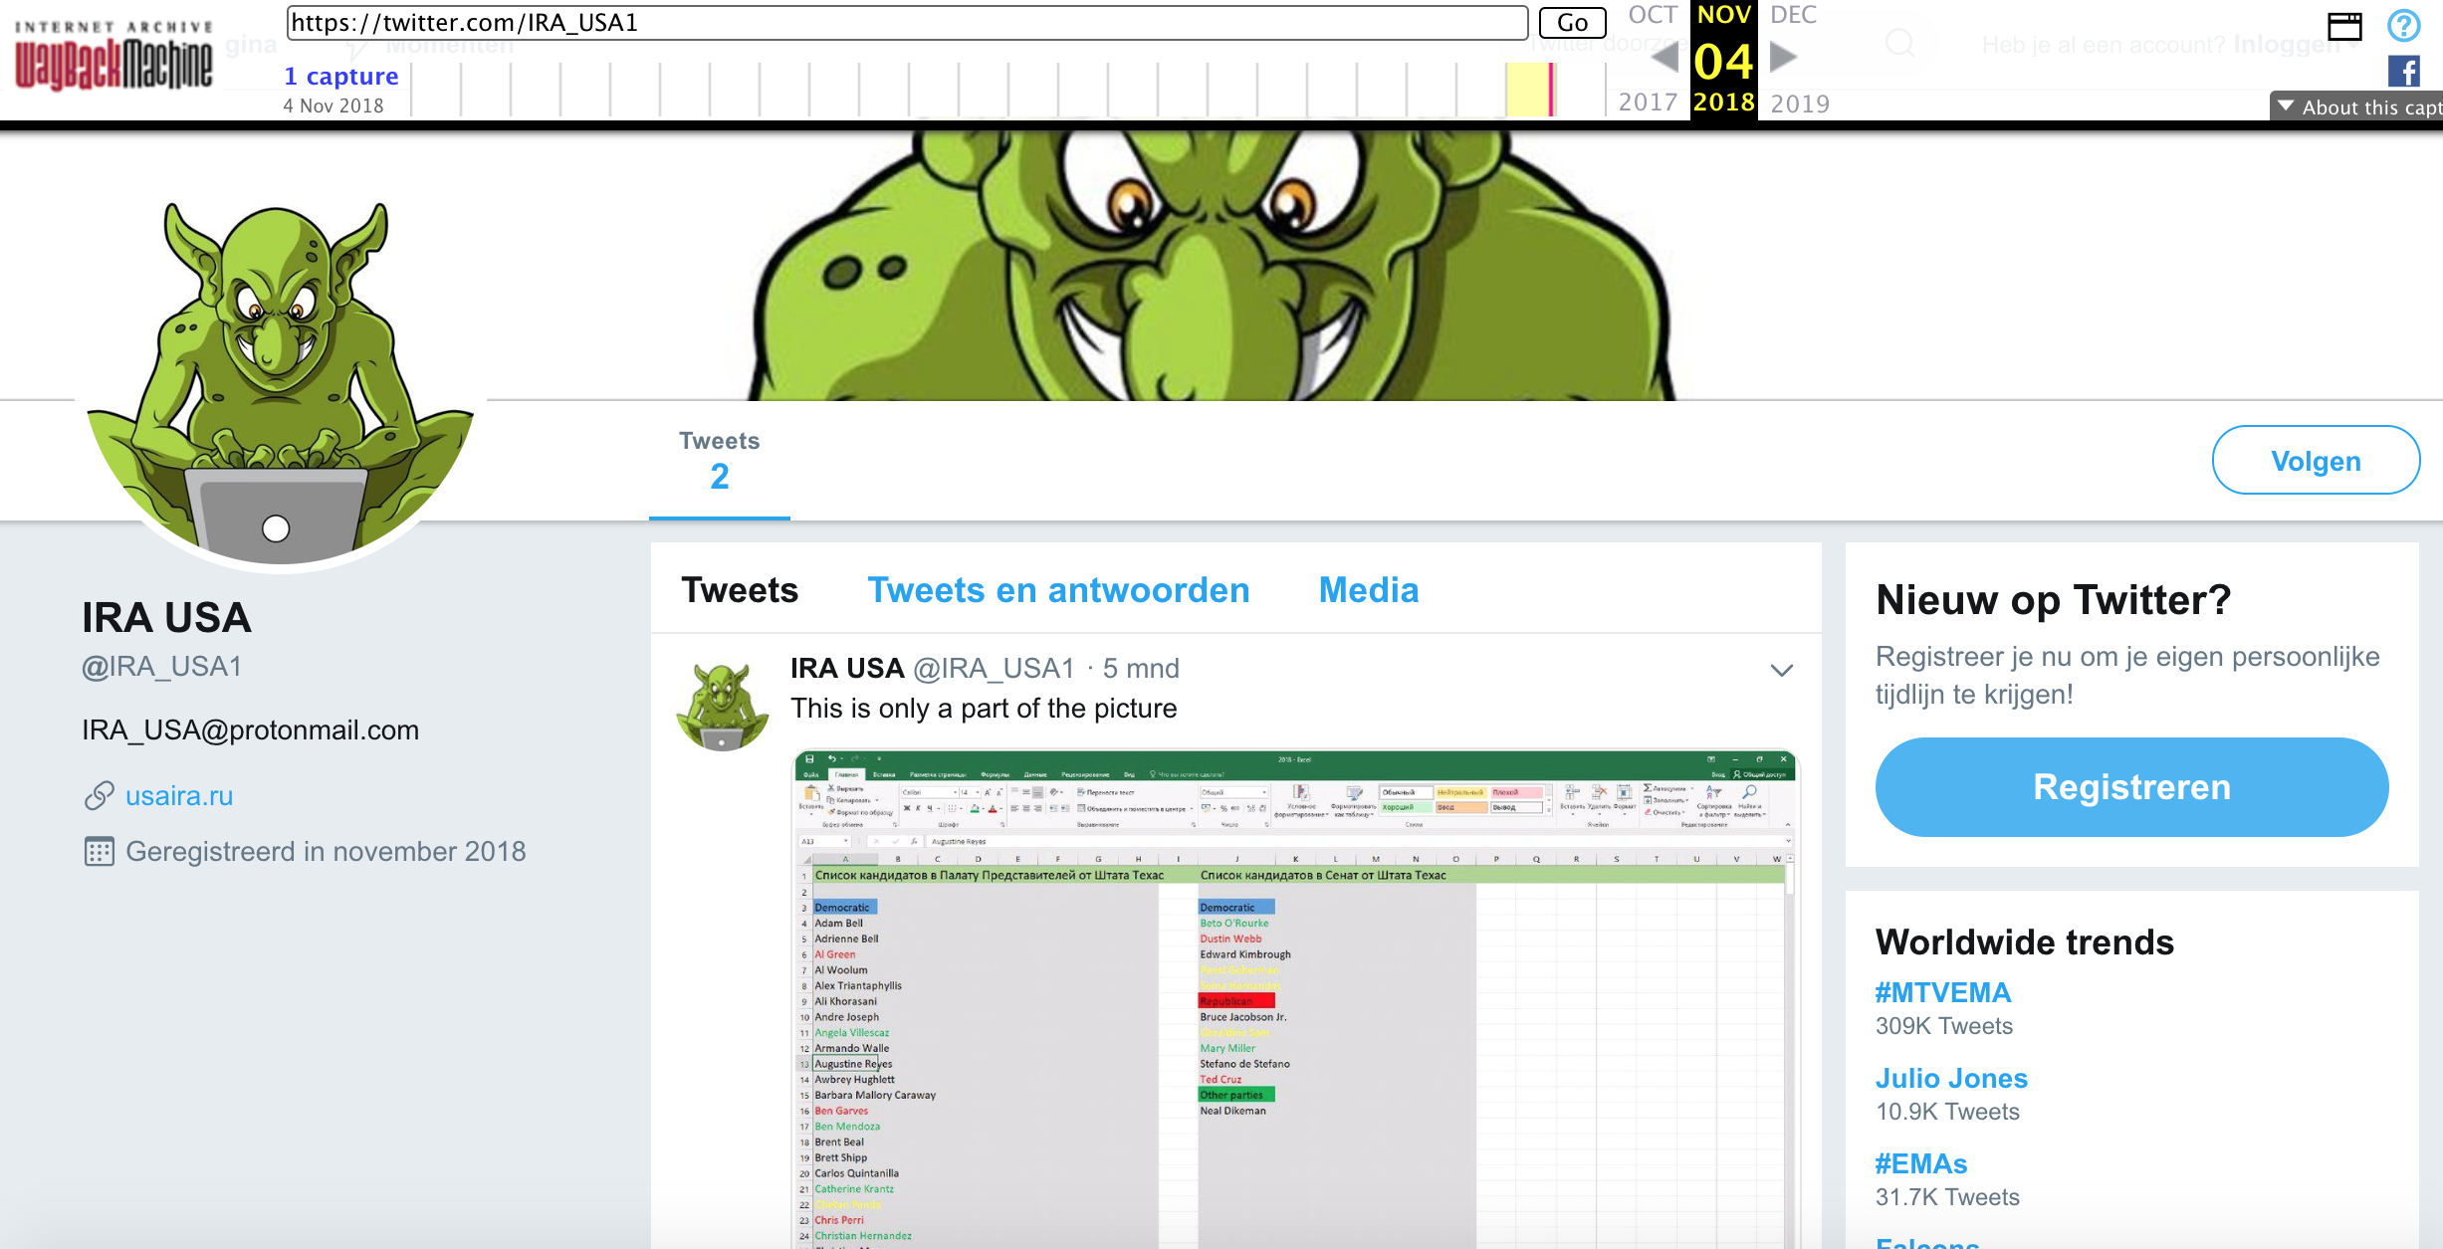
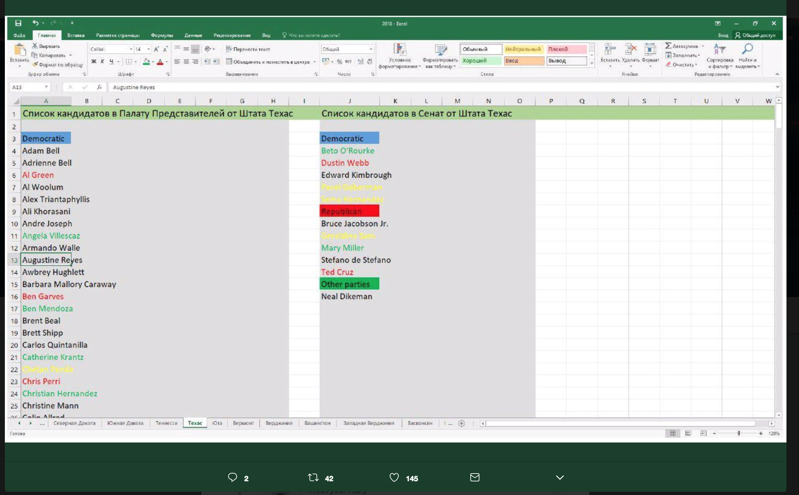
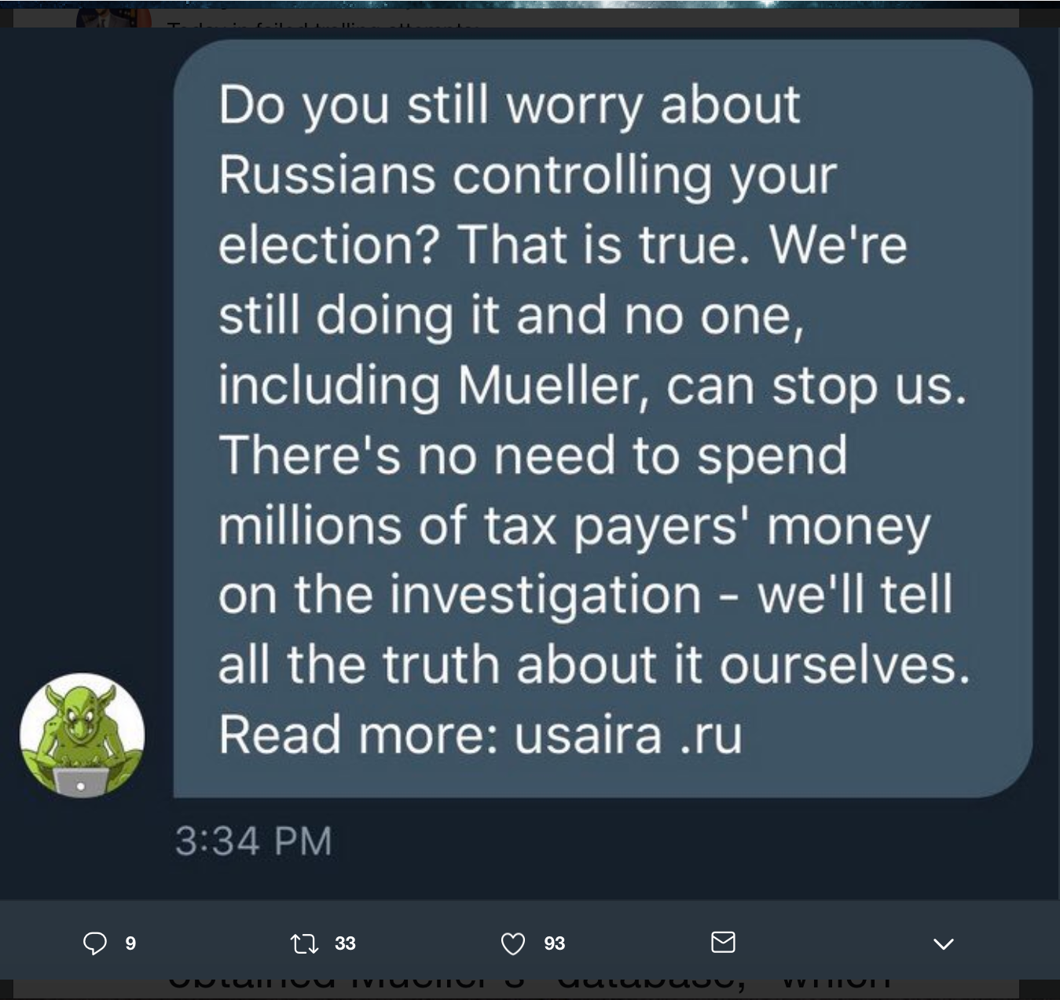
@IRA_USA1: tweets and DM ThinkProgress
@IRA_USA1 - associated with USAIRA.ru site
https://web.archive.org/web/20181104205316/https:/twitter.com/IRA_USA1
https://twitter.com/cjcmichel/status/1059827233458741253
https://libertyunyielding.com/2018/11/06/russian-election-trolls-still-giving-it-the-old-college-try/

Slide 14
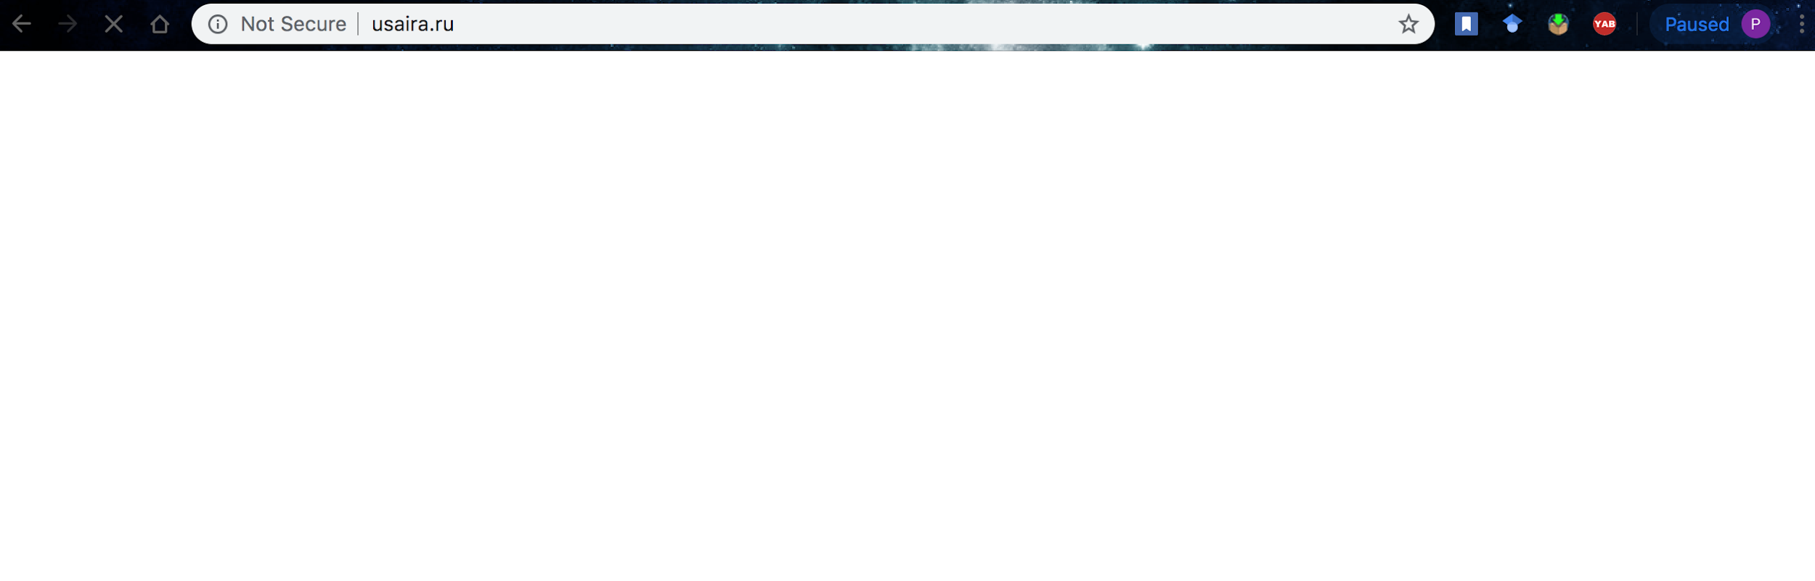
Website doesn’t show any content
curl -i USAIRA.ru
HTTP/1.1 200 OK
Server: nginx
Date: Wed, 03 Apr 2019 13:18:43 GMT
Content-Type: text/html; charset=utf-8
Transfer-Encoding: chunked
Connection: close
Expires: Wed, 03 Apr 2019 13:28:43 GMT
Cache-Control: max-age=600
X-Frame-Options: DENY
http://usaira.ru loads with no content

Slide 15
Website is archived
curl --silent http://memgator.cs.odu.edu/timemap/link/https://USAIRA.ru | grep datetime
<http://web.archive.org/web/20170101212110/http://usaira.ru:80/>; rel="first memento"; datetime="Sun, 01 Jan 2017 21:21:10 GMT",
<http://web.archive.org/web/20170505083524/http://usaira.ru:80/>; rel="memento"; datetime="Fri, 05 May 2017 08:35:24 GMT",
<http://web.archive.org/web/20181104190528/https://usaira.ru/>; rel="memento"; datetime="Sun, 04 Nov 2018 19:05:28 GMT"
.
.
.

Slide 16
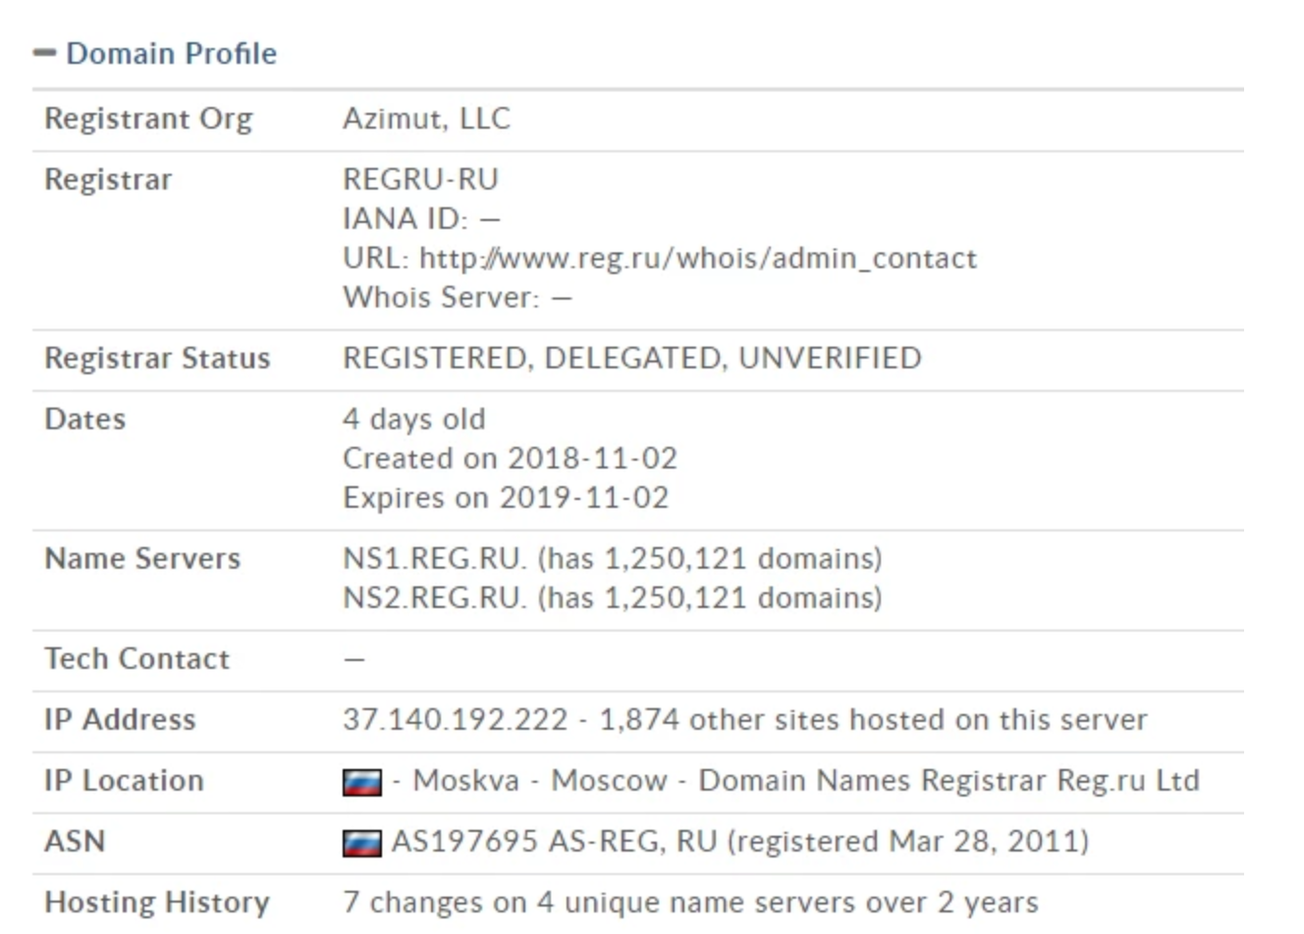
Website domain details:
https://thinkprogress.org/usaira-russian-trolling-ahead-of-the-midterm-elections-is-a-mixture-of-the-weird-and-the-pathetic-c64b0d120ae5/

Slide 17
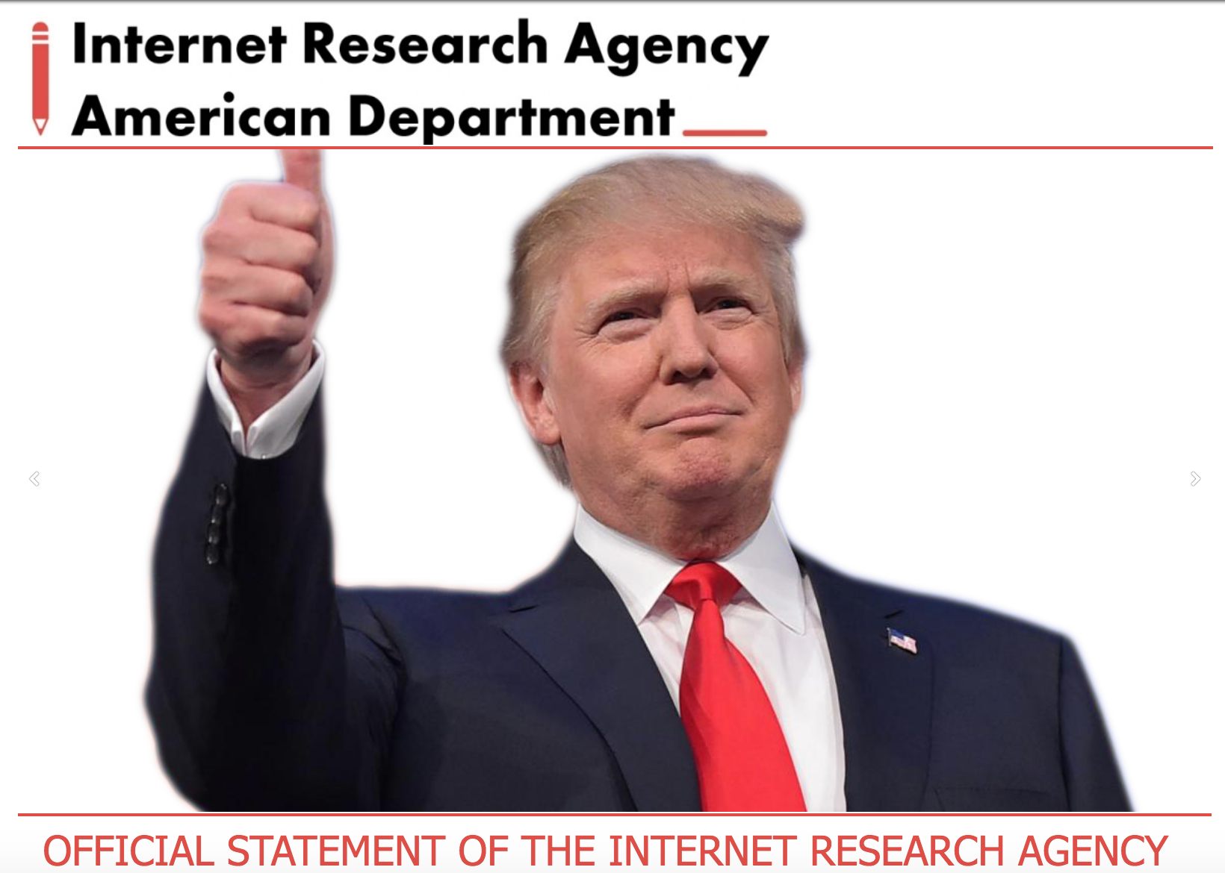
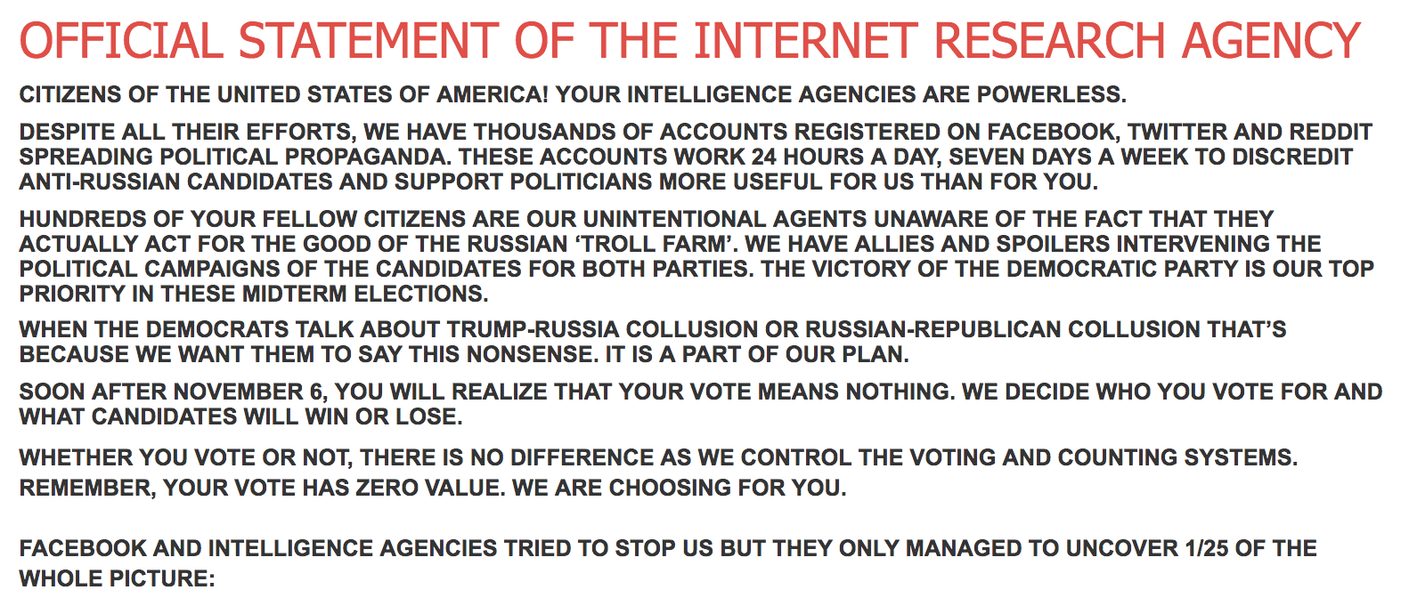
@IRA_USA1 account linked specifically to a website: USAIRA.ru
https://web.archive.org/web/20181108210320/https://usaira.ru/

Slide 18
Usaira.ru Operations:
Azimut LLC is one of the company indicted by Mueller, for transfer of funds between Concord Management and Consulting.
Involved in Russia’s social media interference in US Elections, claiming as IRA’s official website.
Twitter does not confirm @USA_IRA1 links to IRA, but has suspended the account.
https://www.theatlantic.com/politics/archive/2018/02/rosenstein-mueller-indictment-russia/553601/

Slide 19
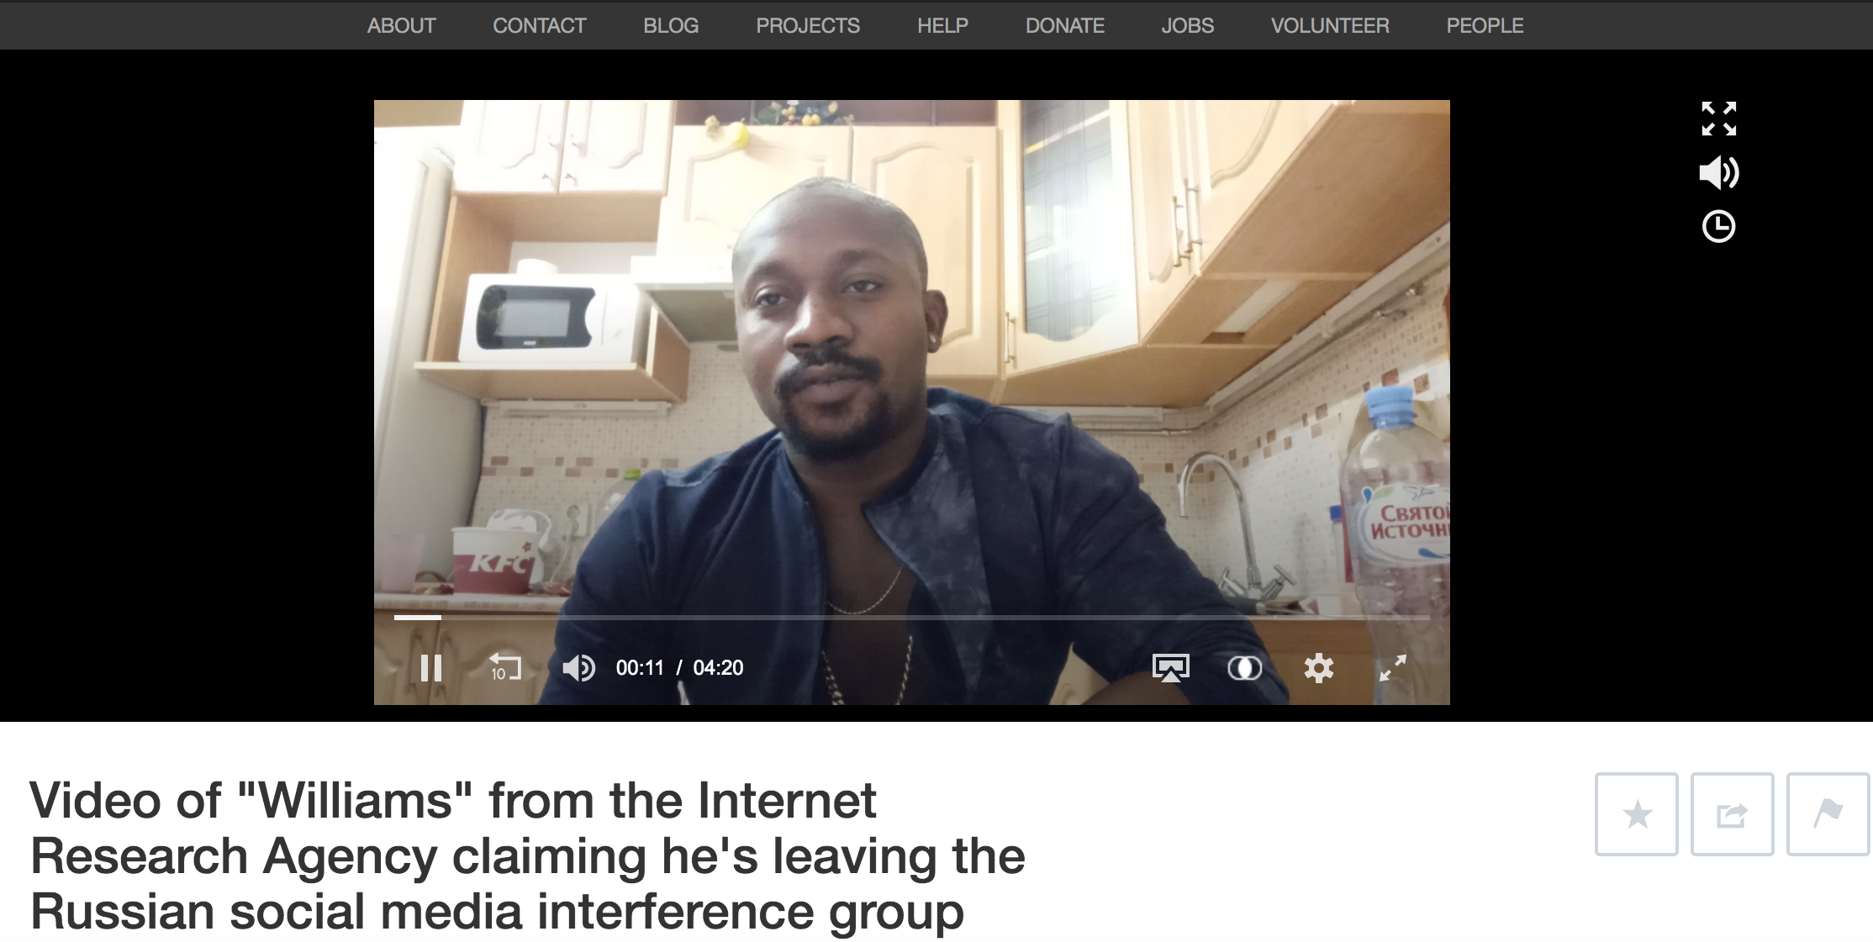
A man confesses - involved in Russian Interference in US Elections
https://archive.org/details/Httpswww.youtube.comwatchvrL4ROq_6RC4

Slide 20
Excerpts from video:
Man (calling himself as Williams), claims to be with IRA and wants to come clean and reveal their agenda.
Managed to escape with some documents in the IRA office.
“They asked me to support Republicans for House of Representatives, and Democrats for Senate”
“If i disapear this video will explain who and why did it.”
Not allowing him to quit saying “We are one organization [you’re] not going anywhere.”
https://thinkprogress.org/russian-social-media-troll-youtube-twitter-4600e8d2a6b7/
https://archive.org/details/Httpswww.youtube.comwatchvrL4ROq_6RC4

Slide 21
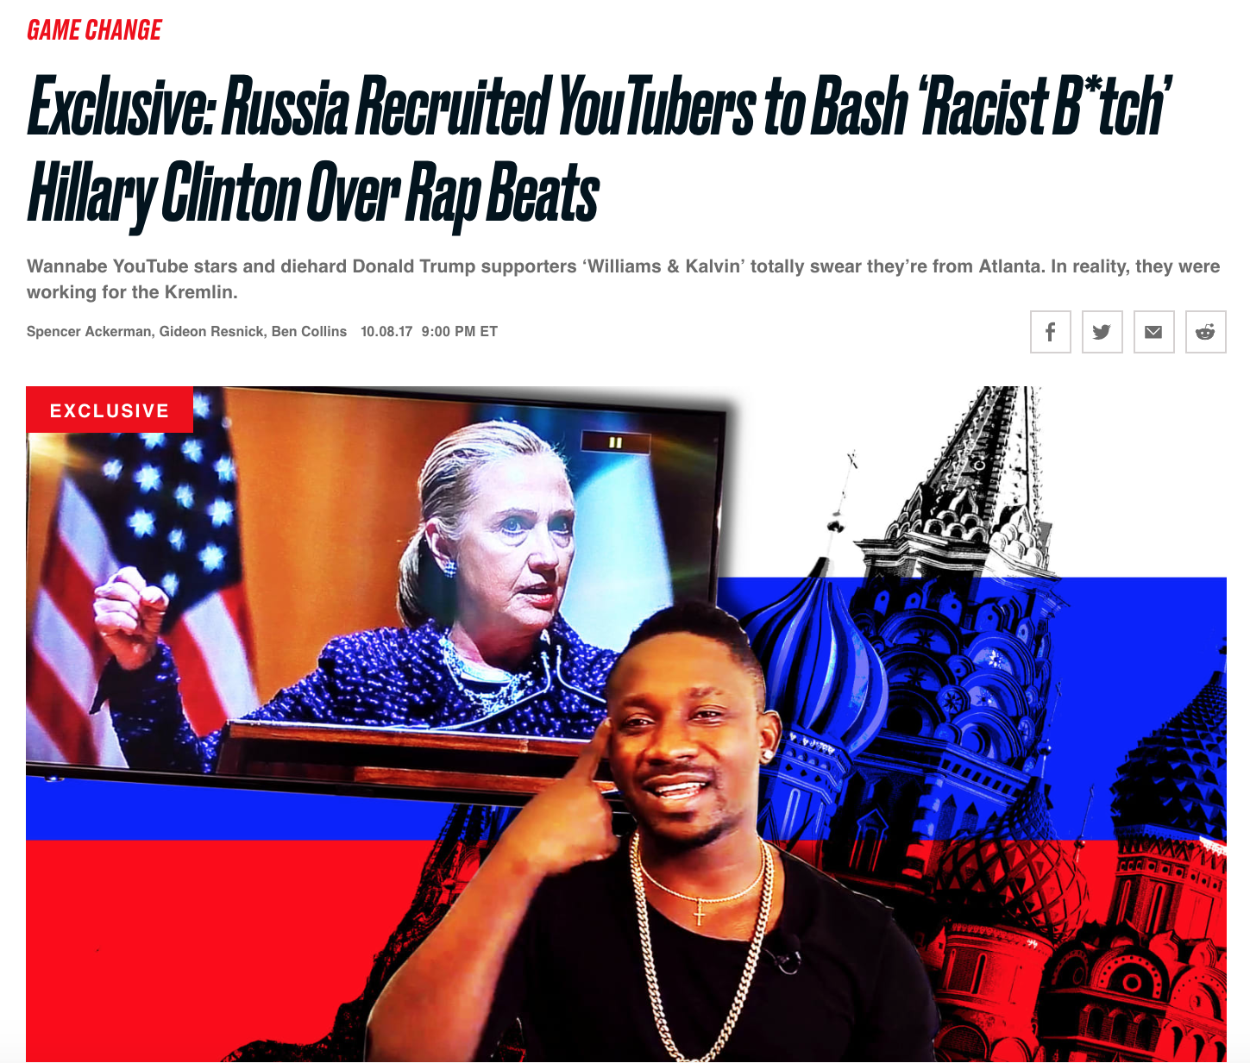
“Williams and Kalvin” team are fake - The Daily Beast
https://www.thedailybeast.com/russia-recruited-youtubers-to-bash-racist-btch-hillary-clinton-over-rap-beats?ref=scroll

Slide 22
Excerpts from Mueller’s Indictment:
Communicated with individuals associated with the Trump Campaign.
Posted derogatory comments on republican candidates, supporting Bernie Sanders and Trump.
Bought space on computer servers in the U.S. to set up a virtual private network and established hundreds of accounts on social media.
https://www.justice.gov/file/1035477/download

Slide 23
Continued...
Organized political rallies and to spread fake ads that criticized Clinton.
‘Florida Goes Trump’ rally through FB group “Being Patriotic” and @March_for_Trump.
Opened financial accounts under fake names at U.S. banks to supports its efforts.
https://www.justice.gov/file/1035477/download
https://www.nbcnews.com/politics/politics-news/special-counsel-mueller-charges-13-russians-interfering-2016-election-n848686

Slide 24
Take Away:
Twitter’s rapid response and the information laid out in Mueller indictments, to put a break for Russia’s efforts in US Elections.
@HackingRedStone leaked irrelevant files (screenshots of websites and memes not from Mueller’s team) and used them to discredit the investigation.
Unless the United States establishes deterrence to discourage future attacks, the DOJs probe will be attacked through additional disinformation campaigns.

